Slide 1


ALMA – Your AI Companion for Better Living
Multilingual AI Chatbot for YouTube Video QA
By: Alvaro Lacave

Slide 2

“Imagine asking health questions and receiving warm, human-like answers — plus tailored video suggestions.”
ALMA is a multilingual, multimodal AI chatbot focused on health & wellness.
It transforms YouTube videos into searchable knowledge in English & Spanish.
Notes:
"Let me introduce you to ALMA — your AI companion for better living.
ALMA is more than just a chatbot. She’s designed to answer your health and wellness questions in a way that feels genuinely human — warm, intelligent, and supportive. Whether you're curious about nutrition, sleep, mental wellness, or healthy aging, ALMA listens and responds in a tone that feels like you're chatting with a real health coach.
What makes her special is that she’s multimodal and multilingual. She understands and responds in both English and Spanish, and she doesn't just give you plain answers — she can also suggest video clips pulled straight from YouTube to support what she’s saying, making the interaction more dynamic and useful.
In short, ALMA turns scattered video knowledge into personalized, searchable conversations — helping you grow, learn, and feel supported along the way."

Slide 3
Source: YouTube videos (health/wellness)
Tool: youtube_transcript_api
Processing: chunking, semantic tagging, OpenAI embeddings
Storage: Pinecone (alma-index, alma-video-index)
Metadata: title, timestamp, tags, URL
Notes:
"This slide gives a quick summary of how I built ALMA’s knowledge base using YouTube videos.
I started with videos focused on health and wellness, which I chose as my main topic. Using the youtube_transcript_api, I was able to automatically extract transcripts from these videos — no manual downloading needed. The subtitles of the video made it way easier.
Next comes the processing step. I broke the transcripts into chunks, used semantic tagging to label them, and applied OpenAI embeddings to convert them into vector format — this step is what allows ALMA to understand and search content based on meaning, not just keywords.
All of this embedded content is stored in Pinecone, where I set up two indexes: one for general Q&A based on transcript chunks, and another for short, tagged video segments that ALMA can recommend during conversation.
Finally, I enriched the data with metadata like the video title, timestamp, tags, and URL — this helps ALMA give more personalized and helpful answers, sometimes even pointing the user to the exact moment in a video that answers their question."

Slide 4
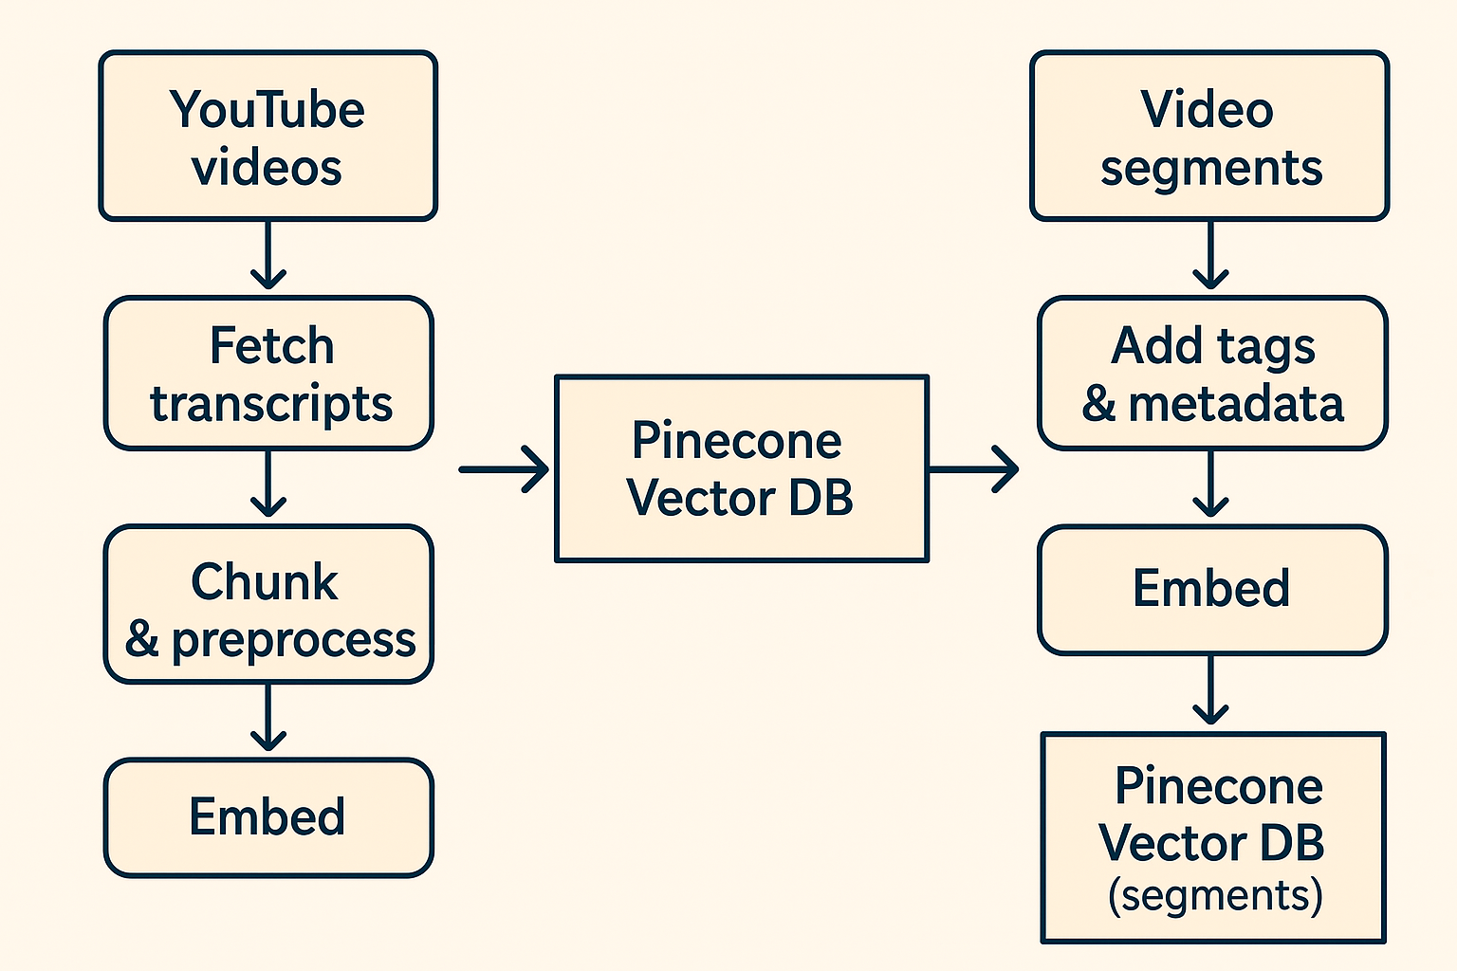
Notes:
It all starts on the left with YouTube videos. First, we collect the transcripts, break them into chunks, and tag each part using OpenAI. Then we also extract timestamped segments that are semantically meaningful — these are stored separately so ALMA can suggest very specific parts of a video.
All these chunks and segments go through OpenAI Embeddings, turning them into vectors that get stored in Pinecone, our vector database. This gives ALMA fast semantic search.

Slide 5
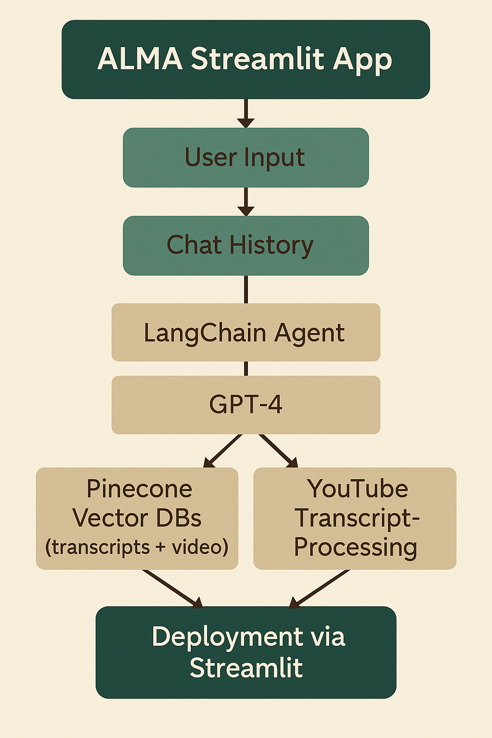
1) User interacts with ALMA through a Streamlit interface, either by typing or speaking.
2) we keep a short chat history to maintain context (gives ALMA a sense of memory)
3) Input flows into a LangChain agent. This agent acts as the brain:
- It uses the calculator tool
- it pulls in relevant context from two sources: A vector database of YouTube transcripts and a second one for tagged YouTube segments, both stored in Pinecone.
All of these are embedded using OpenAI embeddings, which allow the system to understand the meaning behind the content.
4) LangChain agent passes the context and the user’s question to GPT-4, which generates a helpful, emotionally intelligent answer — and even recommends a short video segment if it’s highly relevant to the conversation.
5) The response is delivered through text and optionally spoken back using text-to-speech, creating a truly multimodal experience.

Slide 6
Q&A Agent
LLM: GPT-4 via LangChain
Prompt: Empathetic, multilingual, role-based
Memory: 3-turn chat history
Video suggestion: Similarity search with metadata logic
Retrievers: Transcript-based, video based
Notes:
"This slide shows how ALMA’s Q&A agent works under the hood — blending retrieval, prompting, and memory with GPT-4.
At the top, we have GPT-4 integrated via LangChain. But ALMA isn’t just blindly chatting — she’s guided by a structured logic.
The process starts with two retrievers:
One retrieves transcript chunks from YouTube videos.
The other pulls short, meaningful video segments that I pre-tagged and embedded.
Before sending anything to the model, ALMA builds context using short-term memory.
Here’s how that memory works: I save the last 3 user-assistant exchanges inside a list — this is known as a sliding window memory. When a new message comes in, I take the last 3 turns and reformat them into a mini conversation that’s injected directly into the GPT-4 prompt. It’s not a long-term database — but it gives the assistant enough “recent memory” to make answers feel coherent and follow up naturally.
Then comes the prompt: a carefully designed multilingual, role-based prompt that makes ALMA speak like a warm, thoughtful health coach. This prompt changes depending on whether the user is speaking Spanish or English, and it adds emotional intelligence to every answer.
Finally, if a highly relevant video is found — based on semantic similarity from Pinecone — ALMA decides whether to offer it, always in a soft, helpful tone.
Altogether, this agent setup makes ALMA feel smart, present, and human — not just a chatbot, but a coach that listens, remembers, and cares."

Slide 7

“How ALMA Communicates by Voice”
🎤 Voice Input: ALMA Listens
User selects Voice Mode in the Streamlit app
Microphone records user's voice
Audio is sent to Google Speech Recognition
Speech is converted to text (transcription)
Text is processed like a normal query by ALMA
🔊 Voice Output: ALMA Speaks
GPT-4 generates a text response
Text is sent to Edge TTS (Text-to-Speech)
ALMA speaks using a natural voice (e.g., “Aria” or “Elvira”)
Audio is played back in the Streamlit app
Notes:
"ALMA isn’t just a text-based chatbot — it can actually talk and listen like a real assistant.
When the user chooses voice mode, ALMA starts by recording their voice. We use Google Speech Recognition to convert that audio into text, which is then passed through ALMA’s logic — just like if the user had typed the question.
Then, when it’s time to respond, we use Edge TTS, which is a powerful text-to-speech engine by Microsoft. It takes ALMA’s answer and turns it into natural-sounding audio. Depending on the language, ALMA can speak in English or Spanish using voices like Aria or Elvira.
This multimodal setup makes the experience more engaging, accessible, and human-like — users can actually have a spoken conversation with ALMA."

Slide 8
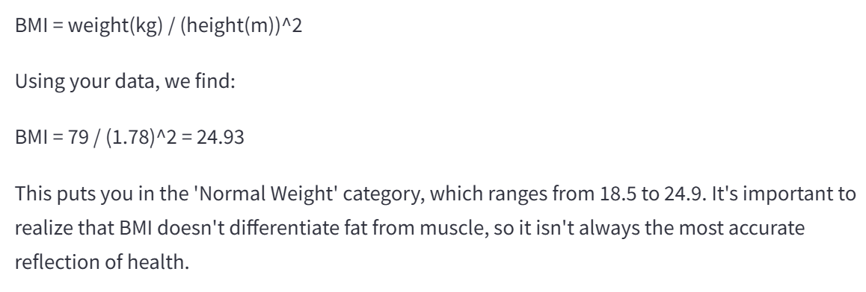
ALMA’s Health Calculator
Top Block: Tool Functionality
Supports:
BMI Calculation
TDEE Estimation
Macronutrient Breakdown
Flow Section:
User types or says a calculator command
LangChain agent detects it’s a math-type question
Routes input to alma_calculator
Returns numeric output
GPT-4 wraps it with ALMA's caring tone
Why it matters:
Useful, real-world functionality
Emotionally intelligent responses
Fully multilingual support
Notes:
"One of ALMA’s tools is a built-in health calculator, designed for things like BMI and TDEE.
I used LangChain’s agent system to integrate it. The way it works is simple but powerful: when a user asks a question like 'What’s my BMI if I’m 70kg and 1.75m tall?', ALMA doesn’t just guess — the agent detects that this is a calculator-type query and hands it off to the tool.
The tool runs the actual calculation, and then GPT-4 wraps that result in a warm, human-style response — something like, ‘Based on your height and weight, your BMI is 22.8, which is in the healthy range.’
This gives ALMA more than just conversation — it gives her actionable utility."

Slide 9
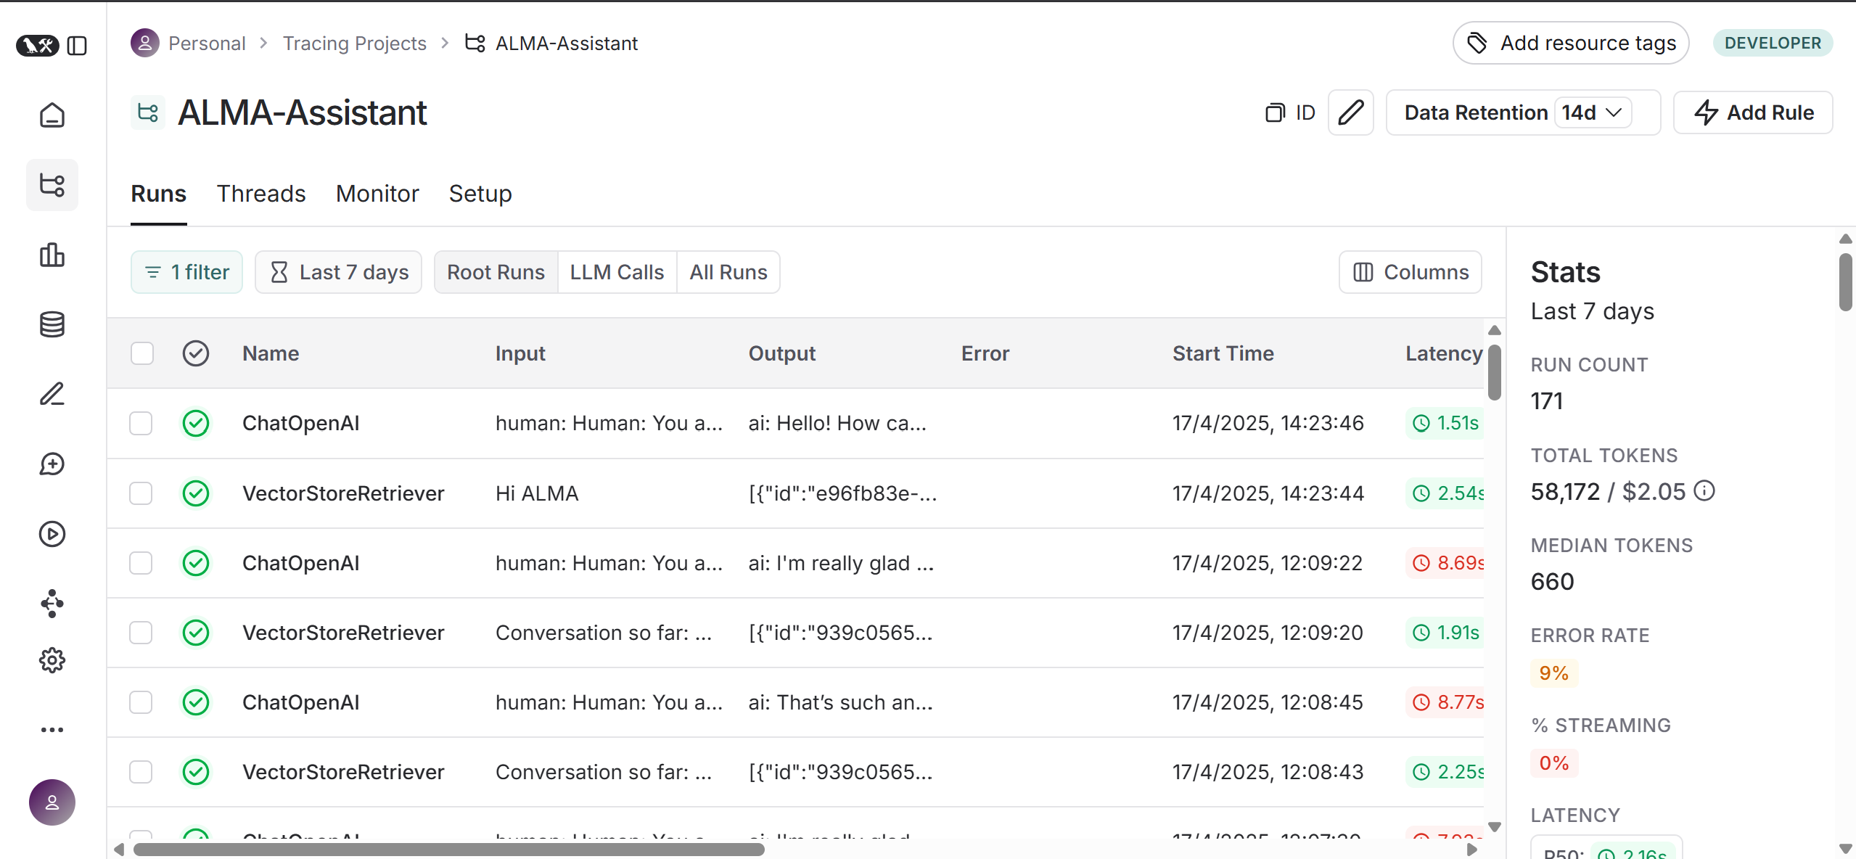
LangSmith Evaluation
Notes:
"This slide highlights how I used LangSmith to evaluate and debug ALMA’s performance during development.
LangSmith gave me full visibility into every interaction between the user and the system — from voice or text input all the way to the final answer. It let me trace how the LangChain agent made decisions: Did it choose the calculator? Did it retrieve the right documents? Was the context passed correctly into GPT-4? These are things you don’t want to guess — and LangSmith made it fully traceable.
Every run is logged with:
The input question
Which tools were triggered
What documents were retrieved
The final GPT-4 prompt
And the full output
This helped me catch mistakes early, like missing video suggestions, low similarity scores, or bad prompt formatting. I could instantly see if the system misunderstood the query, failed to retrieve context, or used the wrong language.
LangSmith was also really helpful for latency tracking. I could measure how fast ALMA responded and optimize the performance where needed — especially with tool use and streaming.
In short, LangSmith acted like a real-time microscope for my AI — giving me transparency, traceability, and the confidence to ship something that actually works well."

Slide 10
